Slide 1
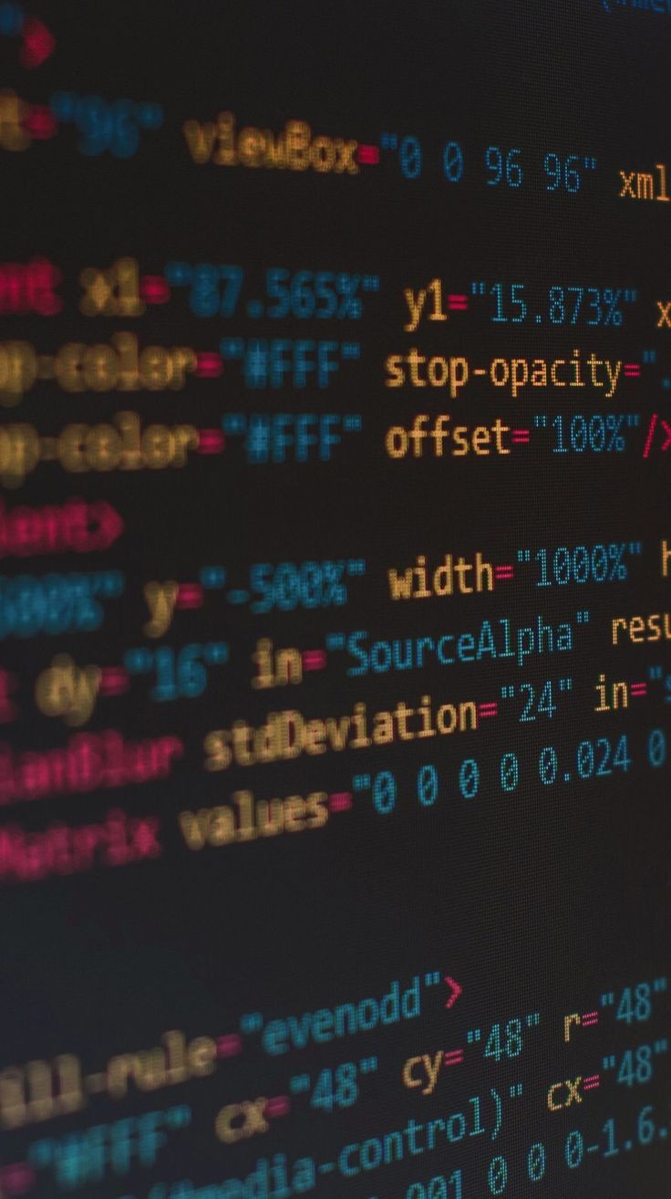
PRORGAMMING
FLELDS

Slide 2
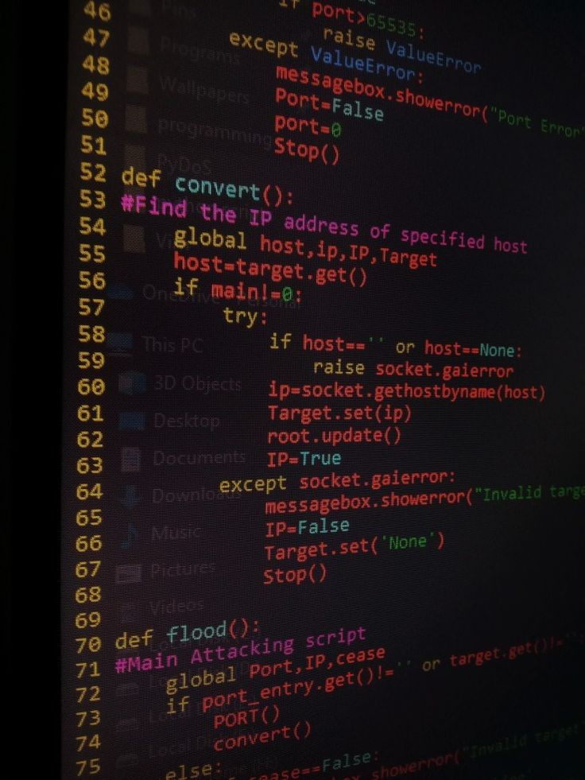
P
rogramming
is how you get computers to solve problems. or Programming means writing instructions for a computer to perform desired actions.

Slide 3
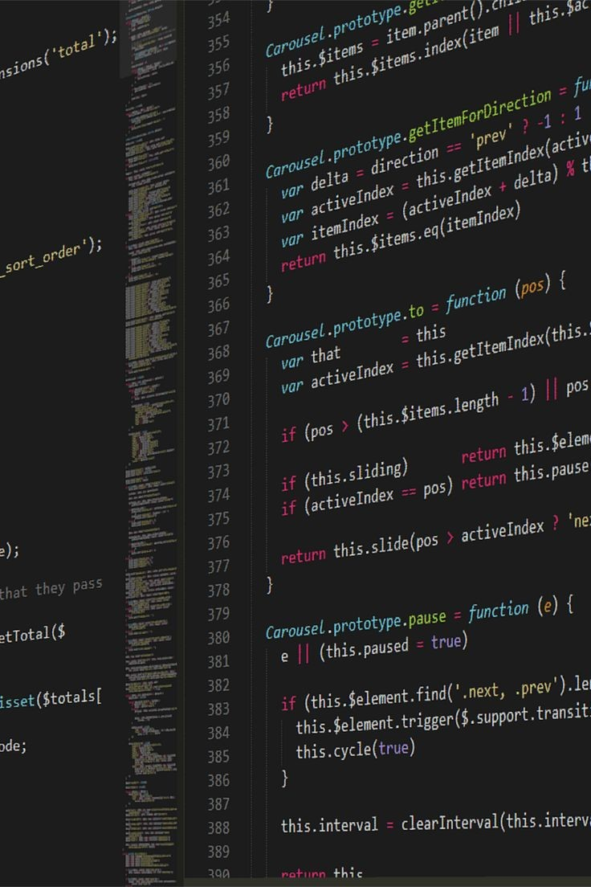
W
hat is a programming Language
A programming language is a language- that a computer understands.
The computer understands only binary language or machine language.
which contains only two digits 0 and 1
These are 0 (means off) and 1 (means on).

Slide 4

Programming languages are roughly categorized into two groups:
1) Low-level programming languages.
2)High-level programming languages.
-Low-level programming language means that the language is close to machine code. This makes it highly efficient. But this also makes it hard for us developers to understand, debug, and maintain.
These days, it is not common to write programs in low-level languages anymore.
a close-up piece of hardware
-High-level programming languages tend to be more “English-like” languages that are easier to learn.
This is because a high-level language is easier to write and read.

Slide 5












PROGRAMMING LANGUAGES:
C++
C#
JavaScript
Java
C
PhP
Python
R
Swift
Kotlin
Matlab
Ruby

Slide 6

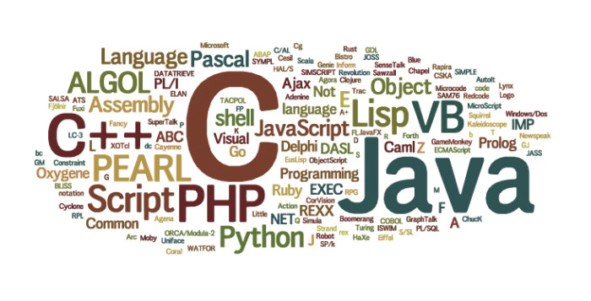
How many programming languages do you think?

Slide 7
GAME DEVELOPMENT
PROGRAMMING FIELDS:
SYPER SECURITY
WEB DEVELOPMENT
DATA SCIENCE
INTERNET OF THINGS
SOFTWARE DEVELOPMENT
ROBOTICS
MOBILE APP DEVELOPMENT
ARTIFICIAL INTELLIGENCE

Slide 8

S
oftware development
is sometimes defined as “a process by which standalone or individual software is created using a specific programming language.”
Software developers develop software applications using a variety of programming languages, each of which is suitable for slightly different tasks. According to the PYPL PopularitY of Programming Language Index,
which is created by analyzing how often language tutorials are searched on Google, the most popular programming language at the moment is Python, followed by Java, JavaScript, C#, and PHP.

Slide 9
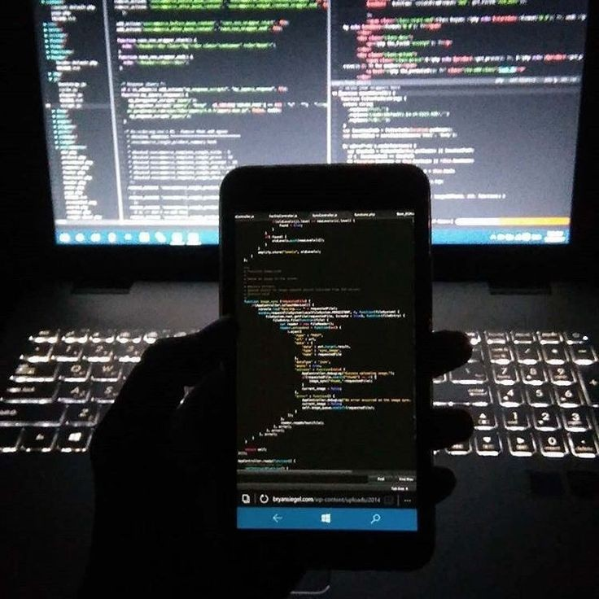
M
obile App developers
are a type of software developer
They specialise in mobile technology such as building apps for Google’s Android, Apple’s iOS and Microsoft’s Windows Phone platforms.
Mobile developers learn the programming languages and software development environment
eg for Android, Objective-C for iOS and C# for Windows Phone Java

Slide 10
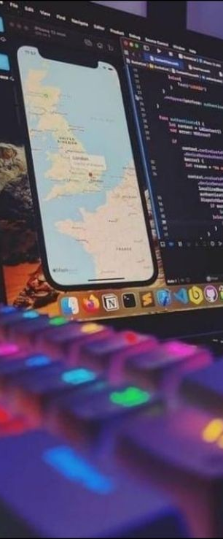
-The typical responsibilities of mobile developers include:
1-discussing the client’s requirements and the proposed solution with colleagues.
2- developing application programming interfaces (APIs) to support mobile functionality.
3- keeping up to date with the terminology, concepts and best practices for coding mobile apps
using and adapting existing web applications for apps.
4- working closely with colleagues to constantly innovate app functionality and design.

Slide 11
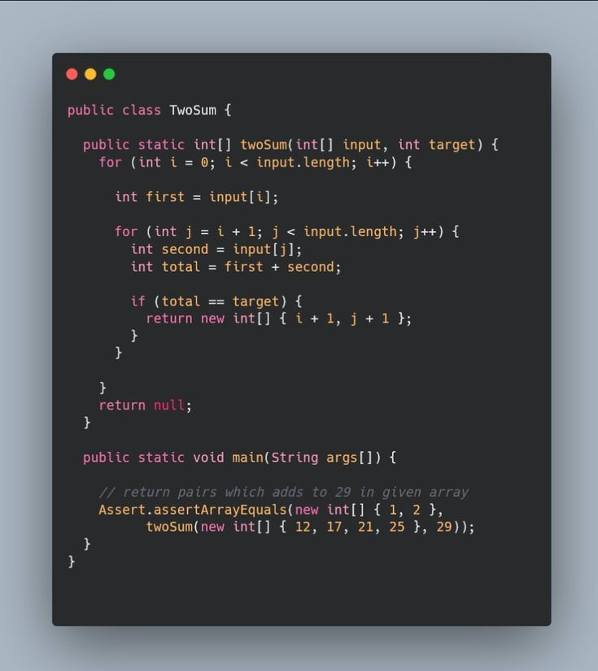
D
ata science
is an interdisciplinary field that uses scientific methods, processes, algorithms and systems to extract or extrapolate knowledge and insights from noisy, structured and unstructured data, and apply knowledge from data across a broad range of application domains . Data science is related to data mining, machine learning, big data, computational statistics and analytics.
What's Database?
"A database is an organized collection of structured information, or data, typically stored electronically in a computer system. A database is usually controlled by a database management system (DBMS).

Slide 12
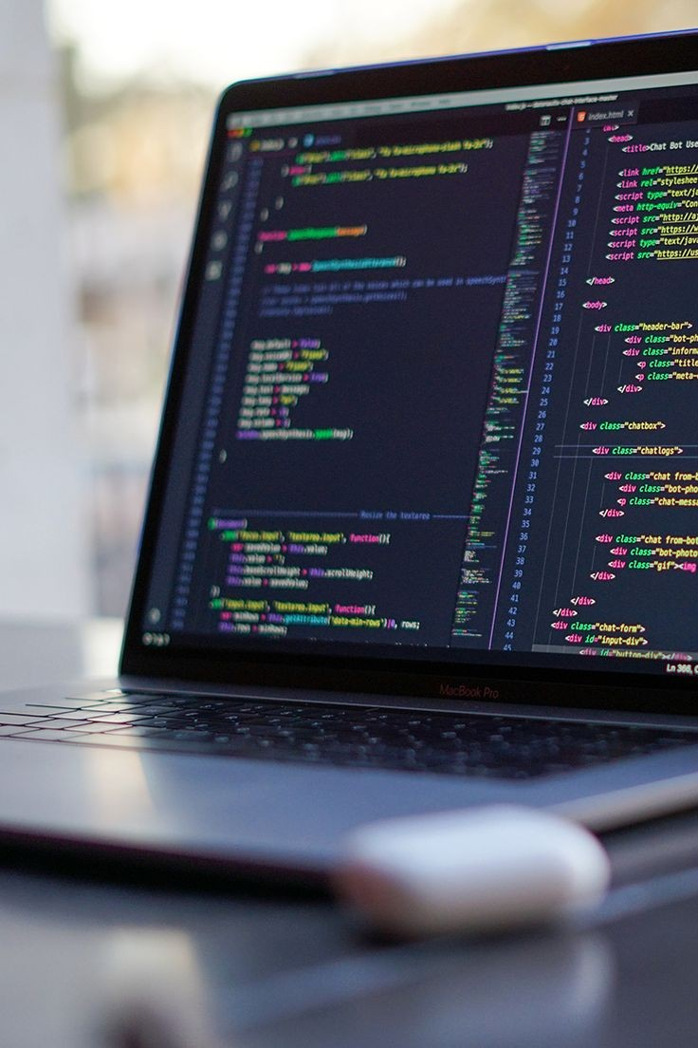
What's Database?
"A database is an organized collection of structured information, or data, typically stored electronically in a computer system. A database is usually controlled by a database management system (DBMS).
The language of using the data is:
R
Matlab
Python
The main contain of database is files , located in storage and cloud.
How to speak with Database?
We speak with Database by program is colled Database Management System (DBMS)

Slide 13
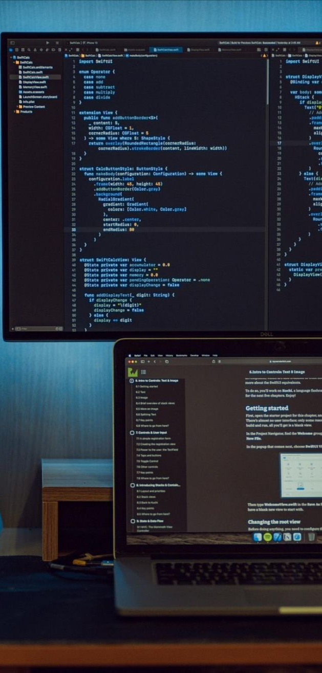
What's The Meaning (Crud Operation)?
It Process To Inside Database,it Is Curtailment For Four Words:-
C:-Creat.
R:-Read
U:-Update
D:-Delete
The Types Of Database?
A) Relationl Database
B) Network Database
C) Nosql Database
What's The Job About Server In Database?
It's Specialized Of Save And Working Database

Slide 14
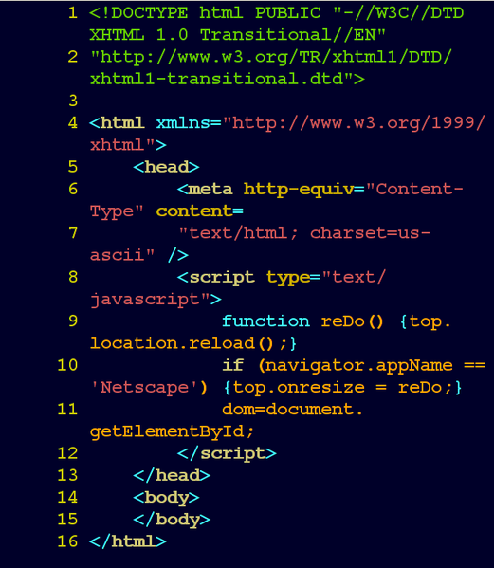
W
eb development
What is the web?
web is a group of many pages, It contains some information ottoched to cech other somehow.
What is the pages?
Is contains of groups from language as like(Thml-Css-Javascript)
-These pages are saved on something colled the (Server),And we see it in something we colled the (browser).

Slide 15
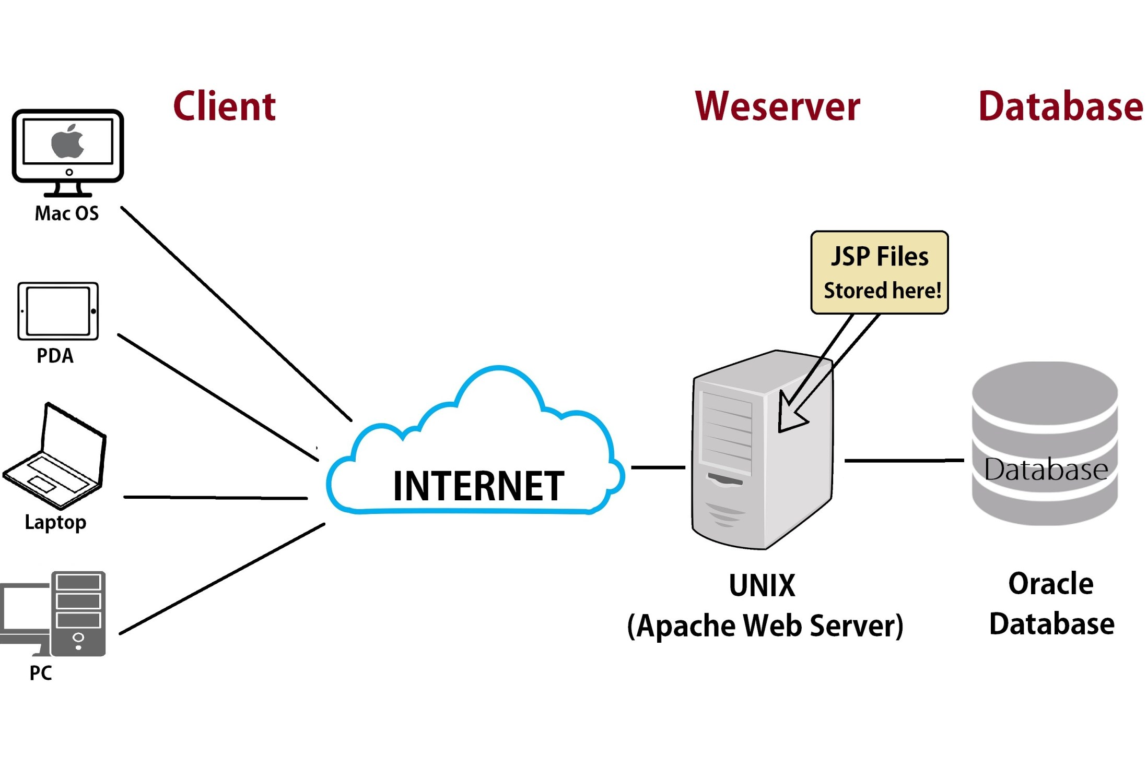
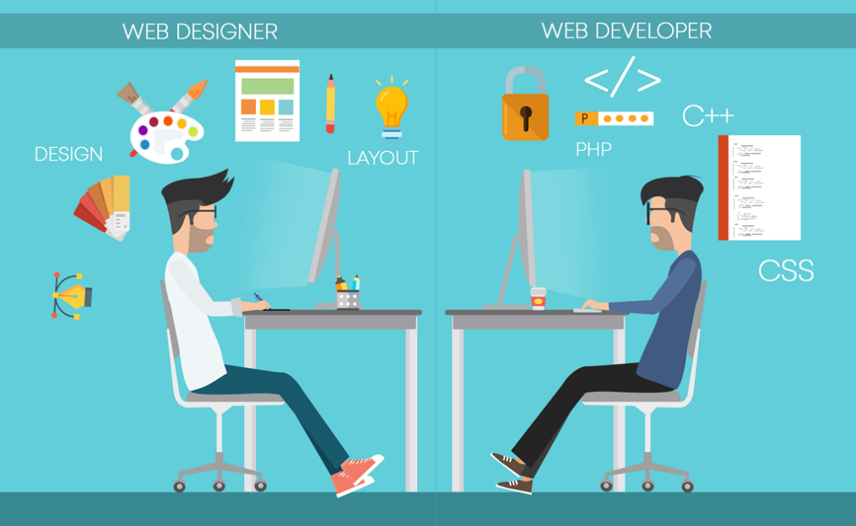
How the web works?
What is the jobs of web?

Slide 16
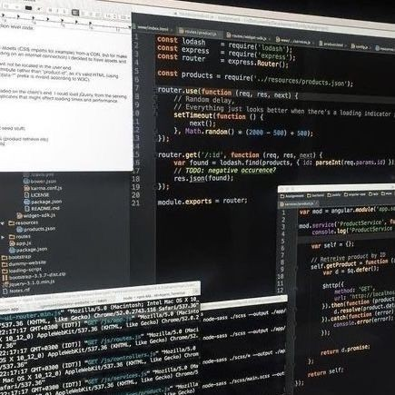
The language of using the web developer is:
1) PHP
2) JS
3) Java
4) Python

Slide 17

S
yper securiy
Types of syper crime:
Hacking:
The protection system for digital devices such as computers and smart phones may be without a goal or a view to controlling some illegal purposes.
Phishing.
Spam Email.
Spyware, Adware.
Malware( Virus, Trojan etc.).
SPAM.
Ransomware.
Cybersecurity: is the protection of systems, networks, applications and programs from cyber attacks

Slide 18

Cybersecurity: is the protection of systems, networks, applications and programs from cyber attacks.
Cyber ​​security goals:
1)integrity.
2)confidentiality.
3)Availability.
The steps of learning cyber security:
-Operating systems: like: windows,linux,Android.
- networking.
programming:
1)C++.
2) JAVA.
3) Python.
4)SQL.
5)PHP.
6)JavaScript.

Slide 19
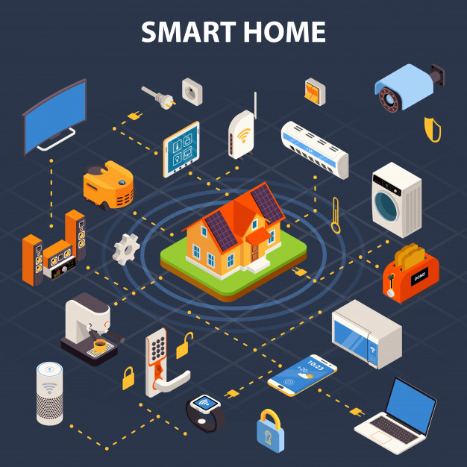
I
nternet of things ( IOT):
The Internet of things may be a system of interrelated computing devices, mechanical and digital machines given unique identifiers and therefore the ability to transfer data over a network without requiring human-to-human or human-to-computer interaction.
IOT componed:
1)Sensors & Actuators.
2)Connectivity.
3)People & Processes.

Slide 20

Sensors :
-Gas
-Sound
-Vision
-Actuators
ROBOGEEH:
-Motion.
-Light.
-Sound.
-Force.
People & Processes:
- Customer Service.
- Control & Automation.
- Analytics & Tracking.

Slide 21
Smart car
Smart city
Wearables
Smart health
Smart appliances
Smart farming
Smart buildings
Smart TV
Smart home
IOT applications:

Slide 22
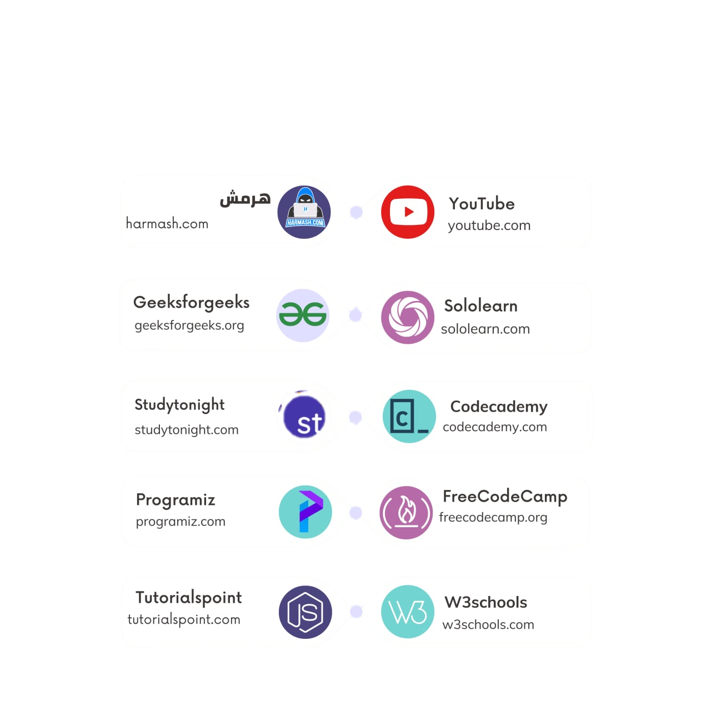

Slide 23


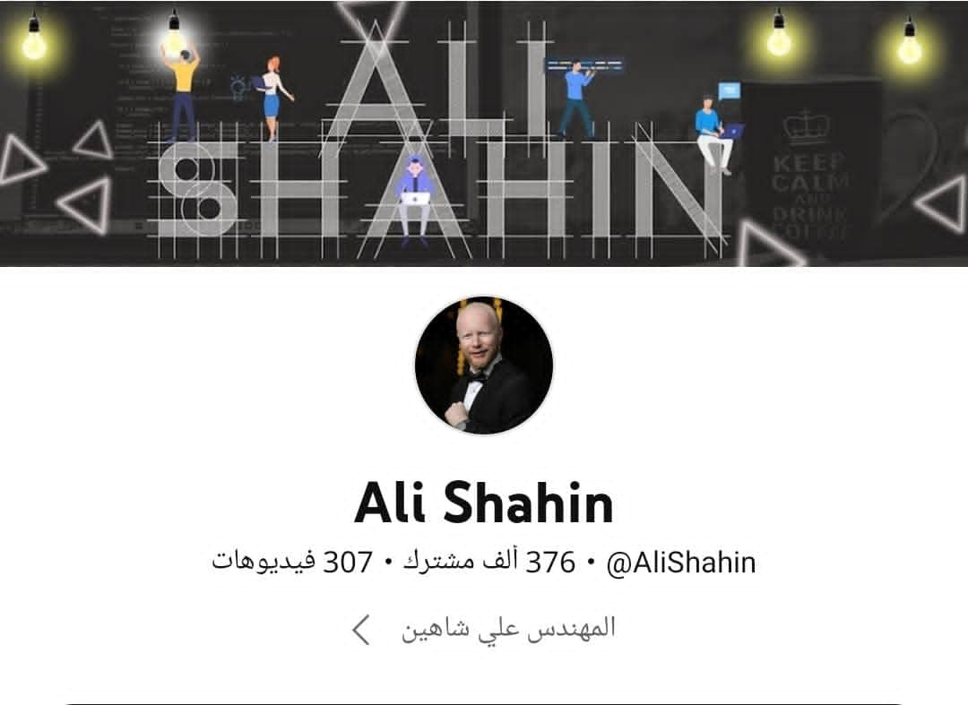
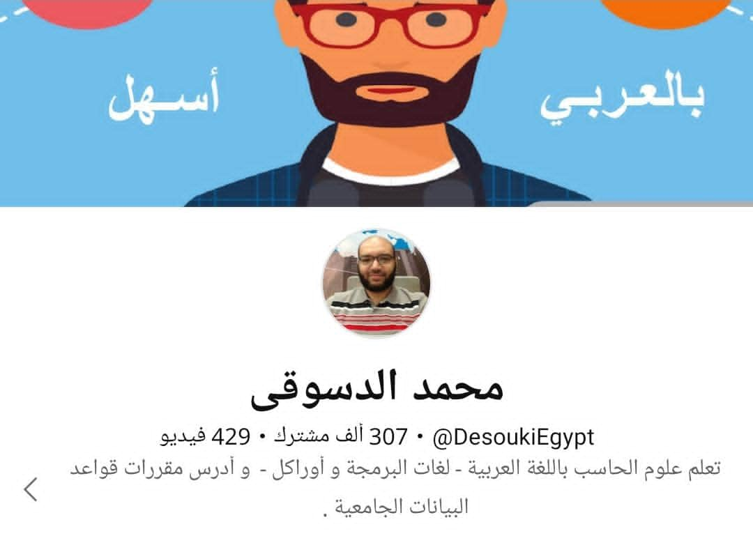
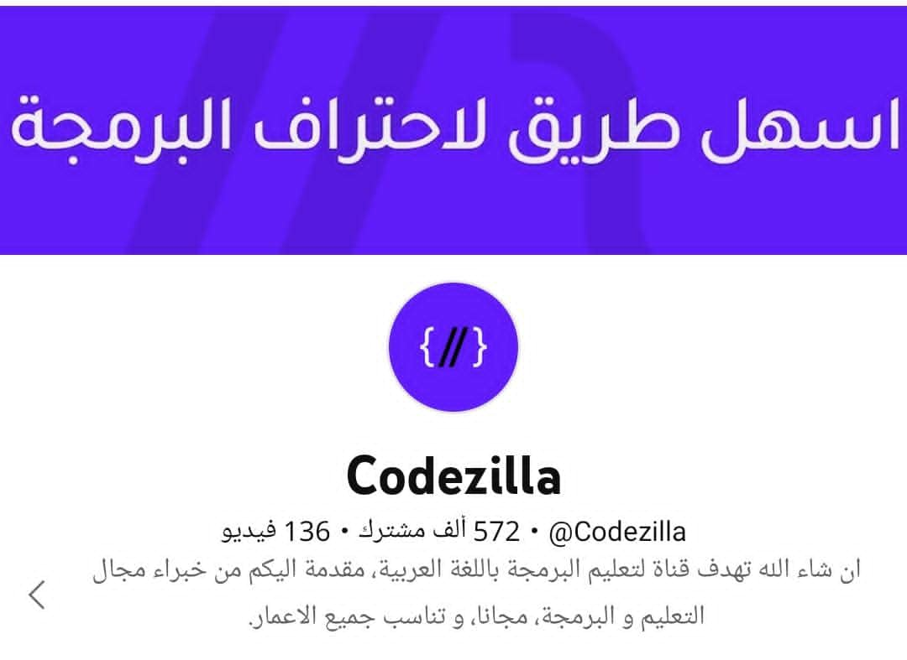

Slide 24

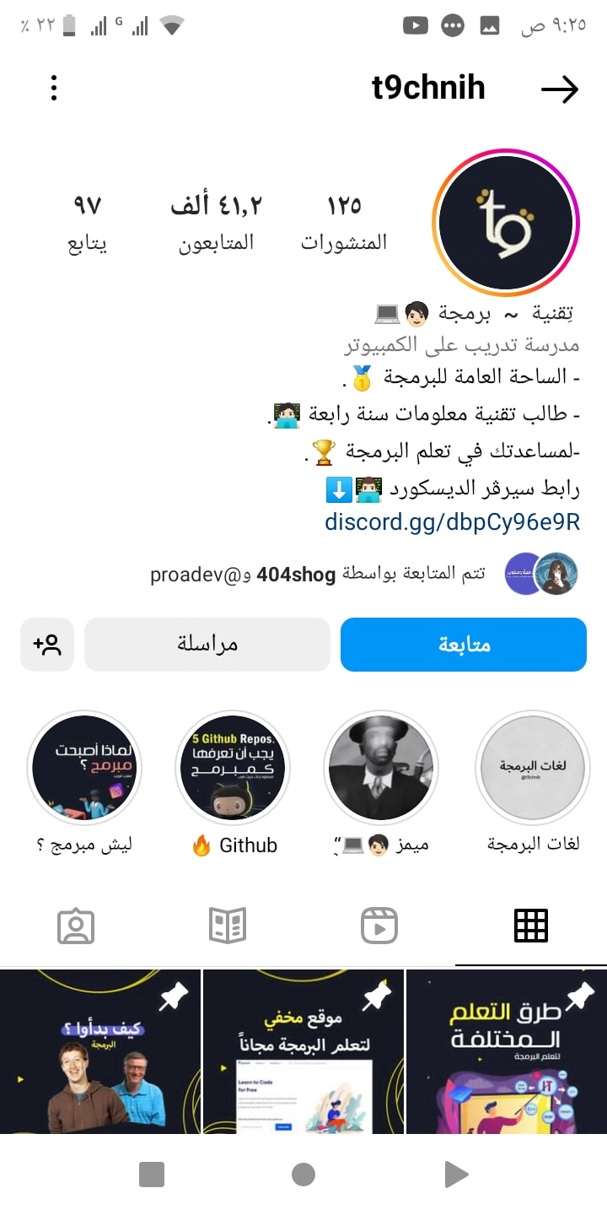
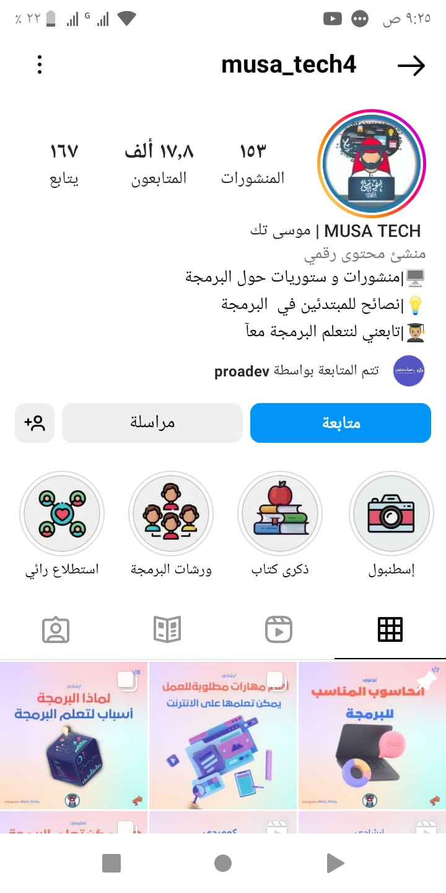
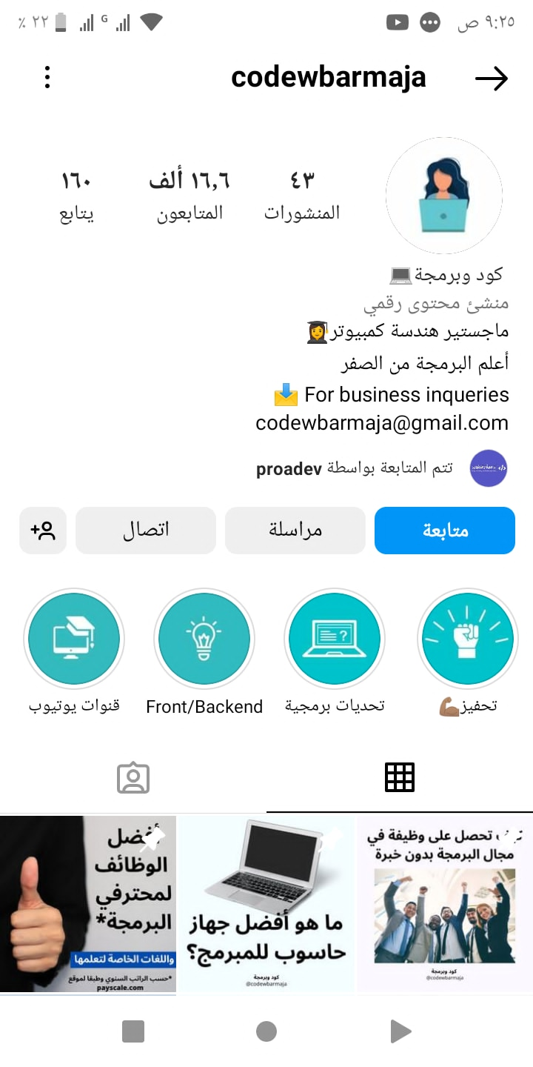

Slide 25

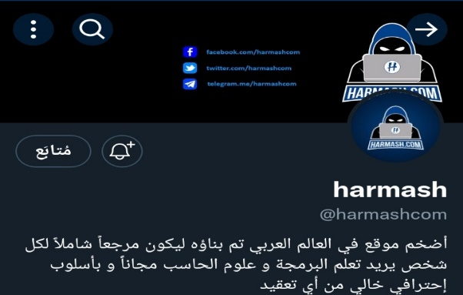
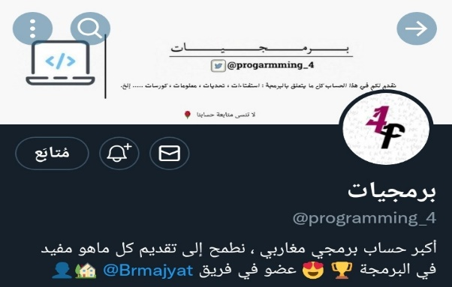
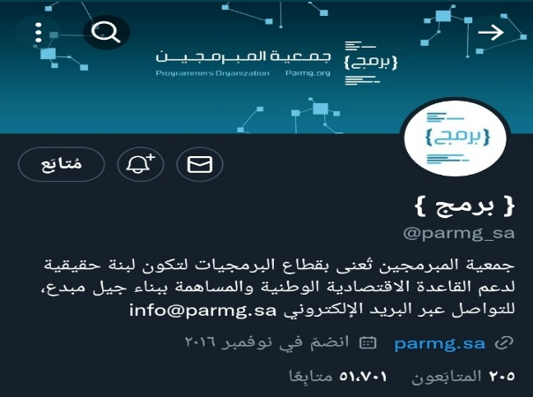

Slide 26


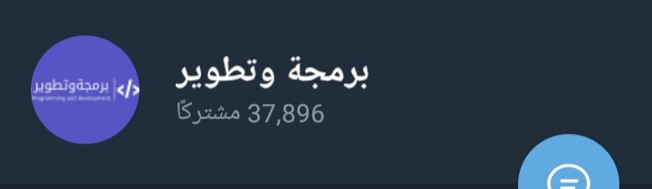



Slide 27
B
y
Noor Mohammed Bawazir
Noor Mohammed Bamakhrama
Wedad Ahmed Al_Yuamini
Afaf Helmi Al-rbaky

